Slide 1
Activity 3:Heuristic Analysis WID3009
Lecturer: Profesor Dr. Loo Chu Kiong
Name :Jasherr A/L M.Ravindran
New Matrices Number: 17195727/1 Old Matrices Number:WID170017

Slide 2
Codes used
if game.is_loser(player):
return float("-inf")
if game.is_winner(player):
return float("inf")
own_moves = len(game.get_legal_moves(player)) #count player move
opp_moves = len(game.get_legal_moves(game.get_opponent(player))) #count opponents move
approx_depth = 49 - len(game.get_blank_spaces()) #get depth
#move to centre
center_spaces = [(3, 3)]
center_value = 0
#counting depth
if approx_depth == 3:
if game.get_player_location(player) in center_spaces:
center_value = 99999
return float(center_value + own_moves - opp_moves - approx_depth * 0.01)

Slide 3
How the code works
When player selects very centre postion, Player is force to take very that position.
Centre position gives player inside track.
Always move to centre when depth is 3.
Counts player's move, opponent's move and depth.

Slide 4
Advantages
Positional advantage -When take centre player has inside track.
Play is kept competitive -When counting depth .If depth is 3,player moves centre
Counts for opponents move.

Slide 5
Result vs other agents
*********
Evaluating: WID170017_Implementation
*********
Playing Matches:
----------
Match 1: WID170017_Implementation vs Random Result: 65 to 15
Match 2: WID170017_Implementation vs MM_Null Result: 59 to 21
Match 3: WID170017_Implementation vs MM_Open Result: 42 to 38
Match 4: WID170017_Implementation vs MM_Improved Result: 34 to 46
Match 5: WID170017_Implementation vs AB_Null Result: 50 to 30
Match 6: WID170017_Implementation vs AB_Open Result: 46 to 34
Match 7: WID170017_Implementation vs AB_Improved Result: 37 to 43
Results:
----------
WID170017_Implementation 59.46%

Slide 6
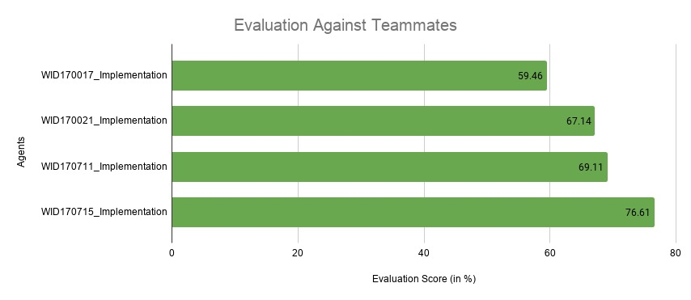
Results compared to teammates

